Slide 1



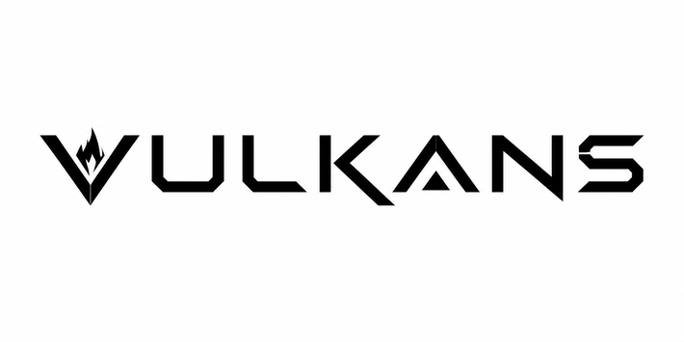
SMART INDIA HACKATHON 2026
  Problem Statement ID – 26151
  Problem Statement Title-Dark web threat actor
de-anonymization
  Theme- Blockchain & Cybersecurity
  PS Category- Software
  Team ID-
  Team

Slide 2
DEIMOS
Dark-web Entity Identification, Mapping & OSINT System
Vulkans
  Problem Statment
    The dark web enables threat actors to hide their identities through Tor hidden services, making attribution difficult. It facilitates illegal activities such as drug and arms trafficking, stolen data, hacking services, money laundering, and terror financing.
How DEIMOS Addresses the Problem
    DEIMOS is an AI-powered OSINT platform that collects and correlates dark-web and clearnet intelligence to connect anonymous threat actors with potential real-world entities.
    Correlates Tor-service vulnerabilities with clearnet infrastructure.
    Links aliases, PGP keys, wallets, and related identities in a unified graph.
    Uses multi-model AI for behavioural analysis and cross-platform persona matching.
Innovation and uniqueness of the solution
    Dedicated X Search for searching aliases on clearnet
    Explainable knowledge graphs show why identities are linked with confidence scores.
    Adaptive persona tracking detects rebranding, migration, and evolving actor behaviour.
    Human-in-the-loop validation ensures reliable and accountable attribution.
    Integrated Dark-web search engine, focused on critical websites.
Bennett University
2
Notes:
2

Slide 3


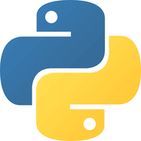

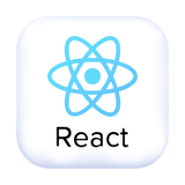

TECHNICAL APPROACH
Vulkans
TECHNOLOGY STACK
Layer | Technology
Frontend | Electron • React • TypeScript
Core Services | Go — crawling & concurrent collection
AI Backend | Python • FastAPI • PyTorch • Transformers • LLMs
Data Layer | Neo4j • PostgreSQL • Elasticsearch
Collection | Tor proxy • OSINT APIs • web crawlers
Deployment | Docker • VPS • optional NVIDIA GPU
IMPLEMENTATION METHODOLOGY
Dark Web & Clearnet Sources
Secure Automated Collection
Profile Construction
Multi-Model AI analysis
Knowledge Graph Construction
Investigation Dashboard, Alerts & Reports
Secure Automated
Collection
Profile
Construction
Multi-Model
AI Analysis
Knowledge Graph
Construction
Dashboard, Alerts
& Reports
Bennett University
3
Notes:
3

Slide 4
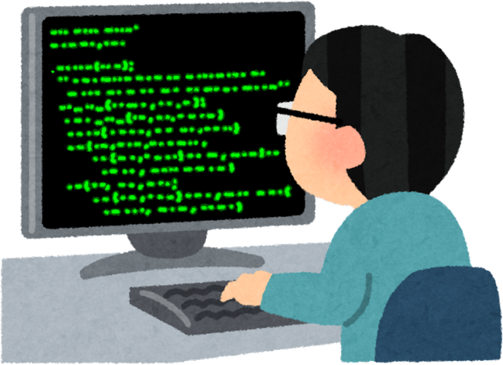
FEASIBILITY AND VIABILITY
Vulkans
FEASIBILITY
Open-source stack
VIABILITY
Focused prototype → secure organization-level threat-intelligence platform
Electron • Go • Python • Tor • Neo4j • AI
Modular design
Phased development, testing & scaling
Automation
Less manual effort & investigation time
Deployment
Standard servers; GPU optional
CHALLENGES & MITIGATION
Challenge / Risk | Mitigation Strategy
Unstable dark-web sources | Monitoring • retries • source archiving
False links / deceptive identities | Multi-source verification • confidence • human validation
AI errors / hallucinations | Evidence grounding • cross-validation • audit trails
Legal / ethical / privacy | Role-based access • lawful-source policies • controlled retention
Sensitive-data security | Encryption • isolated collection • access logs
Bennett University
4
Notes:
4

Slide 5
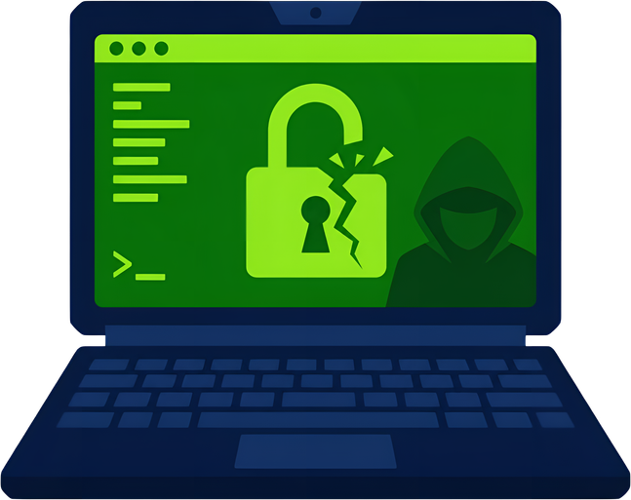

IMPACT AND BENEFITS
Vulkans
POTENTIAL IMPACT
Faster Tracking
Identify & track threat actors
Actionable Intel
Scattered data → evidence-linked intelligence
Better Accuracy
AI correlation + confidence scoring
Early Detection
Cybercrime • illicit trade • fraud • terror financing
KEY BENEFITS
Area | Benefit
Social | Protects citizens & organizations
Economic | Reduces losses & investigation costs
Operational | Saves analyst time; faster decisions
National Security | Stronger monitoring & intelligence sharing
Environmental | Efficient scalable processing reduces unnecessary compute/storage
Bennett University
5
Notes:
5

Slide 6
RESEARCH AND REFERENCES
Vulkans
RESEARCH & REFERENCES
Source | Used For
Europol IOCTA | Europol’s law-enforcement threat assessment of current and emerging cybercrime trends, including dark-web and cybercrime enablers. Link: https://www.europol.europa.eu/publications-events/main-reports/iocta-report
Tor Project Specifications | Official technical reference for understanding Tor and onion-service architecture, privacy features and protocols. Link: https://community.torproject.org/onion-services/overview/
VeriDark — NeurIPS 2022 | Research benchmark for verifying and identifying authors from dark-web text, useful for cross-platform persona matching. Link: https://proceedings.neurips.cc/paper_files/paper/2022/hash/64008fa30cba9b4d1ab1bd3bd3d57d61-Abstract-Datasets_and_Benchmarks.html
DarkBERT — ACL 2023 | Dark-web-specific language model research used as a reference for analysing language and textual patterns in dark-web content. Link: https://aclanthology.org/2023.acl-long.415/
MITRE ATT&CK | Knowledge base of real-world adversary tactics and techniques, useful for mapping observed threat-actor behaviour. Link: https://attack.mitre.org/
Neo4j Graph Technology | Graph-database technology for storing and analysing connected entities and relationships used in DEIMOS knowledge graphs. Link: https://neo4j.com/product/neo4j-graph-database/
Bennett University
6
Notes:
6

